Slide 1
UVA Brainhack!
===== Week 1=====
5/30/2025

Slide 2


Icebreaker
What’s your favorite comfort food?

Slide 3

What is this?
Inspiration
“Although scientific conferences and workshops seem like a natural medium for brain researchers to meet and exchange ideas, in practice these events, often structured around the lecturer–audience paradigm, do not always provide sufficient flexibility or free time to fully exploit their potential” (Craddock et al, 2016)
“Brainhack is an innovative meeting format that promotes scientific collaboration and education in an open, inclusive environment” (Gau et al., 2020)
Goals
Develop a culture of open, inclusive, community-driven neuroscience
Accelerate the pace of discovery – emphasis on collaboration over competition
Notes:
Brainhack is an “unconference” format
The term hackathon is a portmanteau of “hacking” and “marathon.” Traditionally, it is an event in which people and teams gather to collaboratively work on projects over the course of multiple days. These events often historically feature competitions between teams. Brainhacks instead emphasize collaboration over competition.

Slide 4





Logistics
Weekly meetings: room reserved Fridays @noon-5pm
Lunch-&-learn sessions (1-2hrs)
Lunch provided!
Submit/update orders by Wednesday afternoon
Presentation + discussion
Usually me, but lmk if you want to present ☺
Hacking time (remainder)
Solo and group coding projects – time to get help/collab
BYOC
No homework/assignments
Notes:
You don’t need to stay here for 5 hours – I won’t hold you hostage
A few years ago, our lab used to host weekly meetings like this, but they were totally unstructured – basically just a time to hang out and code. I thought it would be a good idea, if I wanted to bring this back, to introduce more formal instruction as a supplement to unstructured hacking time

Slide 5
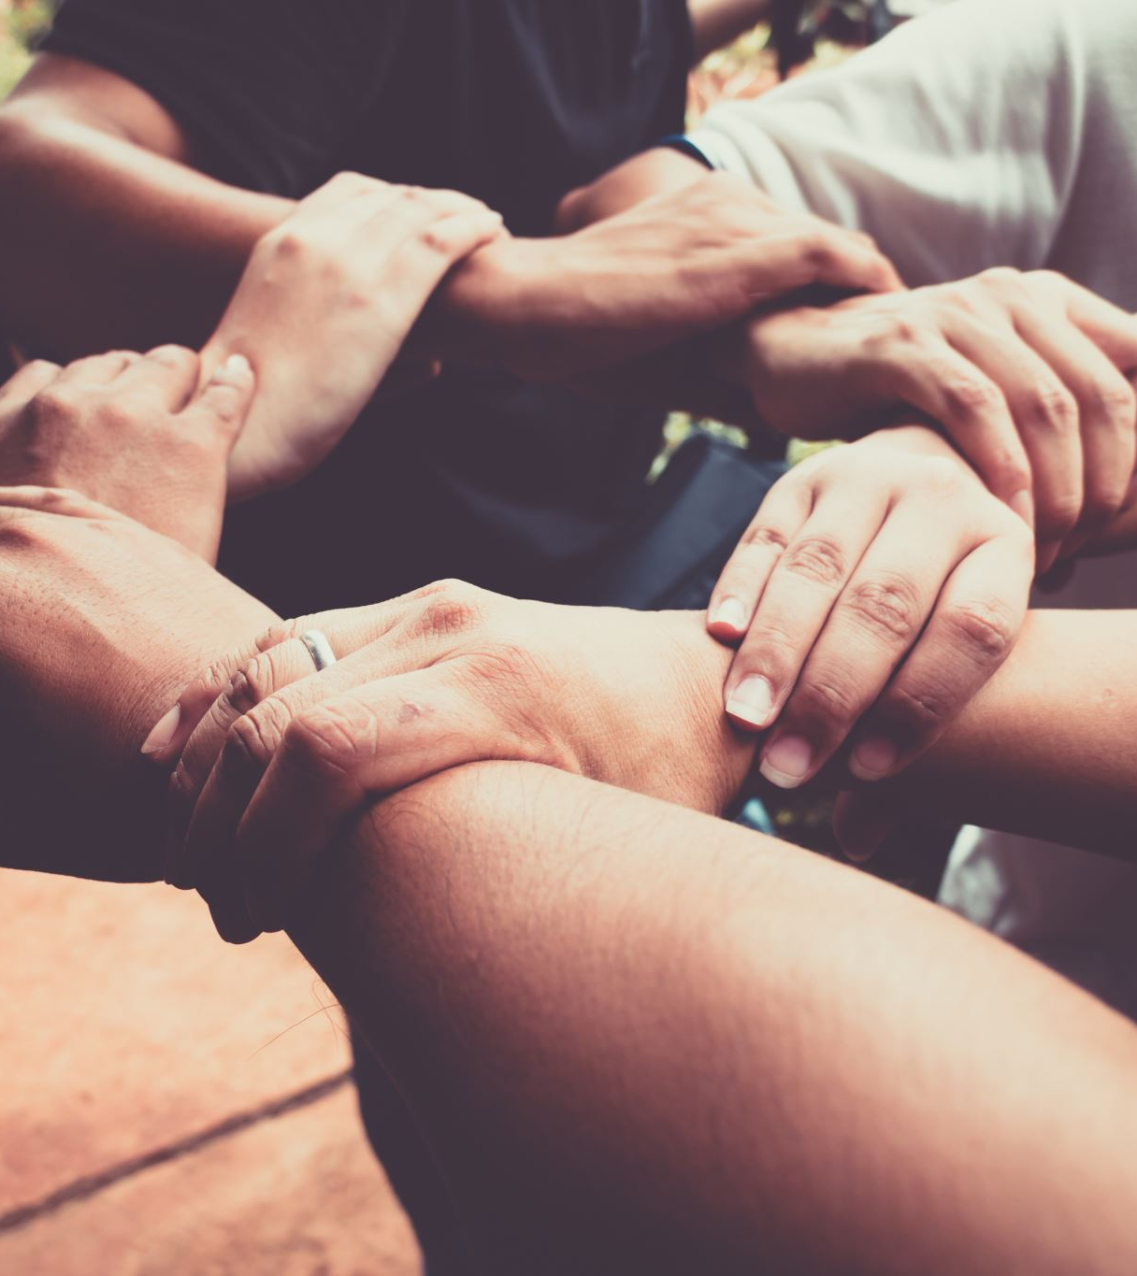
Ground Rules
Be kind/respectful
Be willing to collaborate
Give help, share your knowledge
Ask for help when you need it
Be patient
With others
With yourself – don’t give up!
Try your best
Have fun!
Notes:
Be kind, be respectful – let’s try to build some rapport amongst ourselves
Don’t be embarrassed to ask for help! Don’t be shy!
Give people the time they need to learn/process new material. It’s important to recognize that we’re all starting from different levels of experience. The more programming experience you have, the easier it is to pick up new tricks. Once you know the basics, the rest comes easy (or at least faster)
No grades, no final reports. You get out what you put in.
Celebrate progress

Slide 6
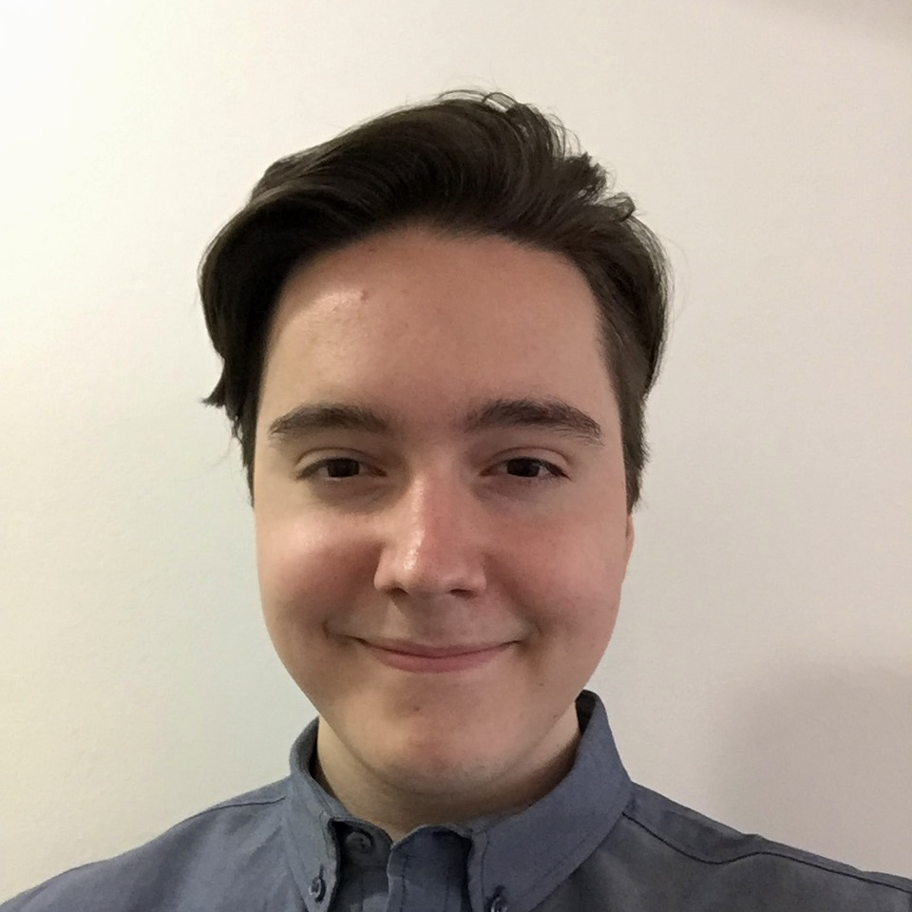

Who am I? (Credentials)
10+ years of programming experience (sort of)
R, Python, Bash, Matlab, C/C++, Java, HTML/JavaScript, Lean, Arduino, x86 Assembly
5+ years in neuroimaging
FSL, SPM, FreeSurfer, AFNI, ANTs, Nipy, etc.
Formal Coursework (UVA):
CS 1111 Intro. to Programming
CS 2102 Discrete Mathematics
CS 2110 Software Development Methods
CS 2150 Program & Data Representation
CS 3102 Theory of Computation
CS 4710 Artificial Intelligence
PSYC 5323 R in Psychology
PSYC 5710 Machine Learning & Data Mining

Slide 7

Who am I? (Un-credentials)
BA in Psychology (no degree in CS)
Never worked in “industry”
Never made+distributed an app
I don’t write production-level code…
Never made or edited a package for Python/R
If it ain’t broke…
Use Stack Exchange & ChatGPT daily
Understanding > memorization

Slide 8
Who am I?
Notes:
I am simultaneously a dweeb and not a dweeb. Given what I know, I’m going to try my best to lead and instruct as much as I can, but I haven’t done this before, and I’m far from being an expert programmer.
I’m hoping the experience I do have will come in handy, and that I can serve as a helpful resource throughout the summer. But really, this will be a team effort!

Slide 9
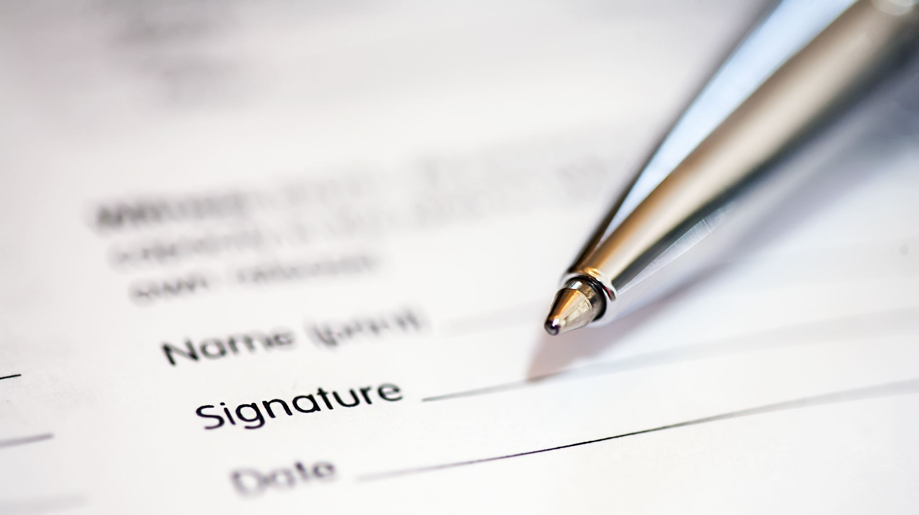
Interest Form
Who are you?
Response summaries

Slide 10
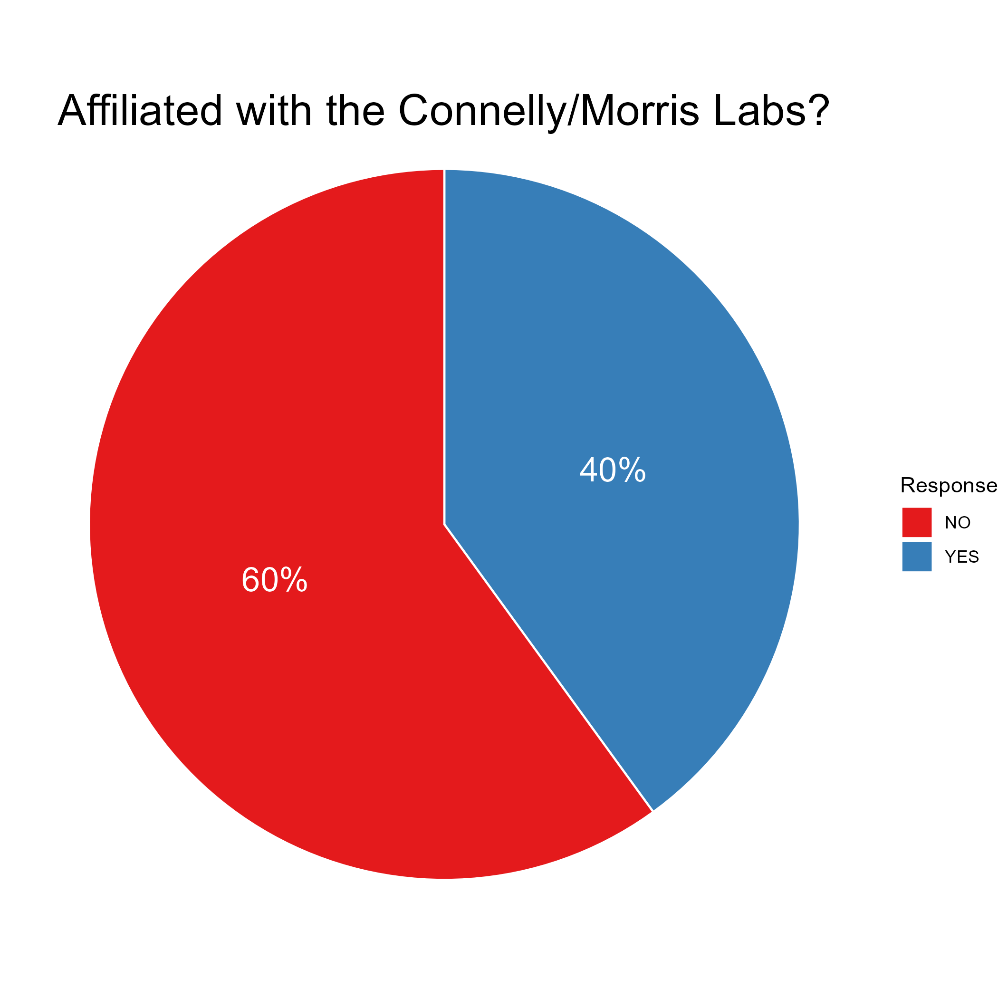
Lab Affiliation
Notes:
Diversity is the heart of Brainhack!

Slide 11
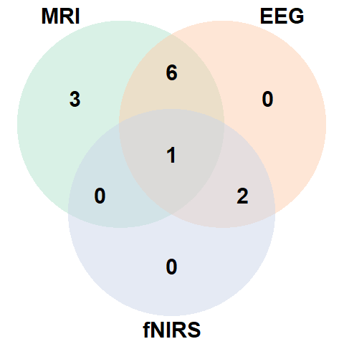

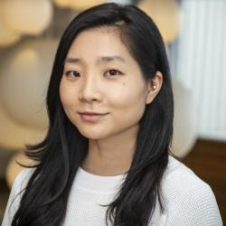
Imaging Modalities
Notes:
Raise your hand if you’ve done _____

Slide 12
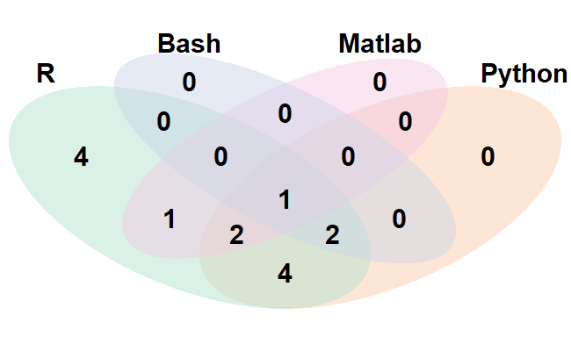
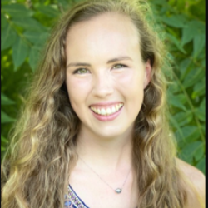
Programming Languages
R > Python > Matlab > Bash
Notes:
Raise your hand if you’ve done _____

Slide 13
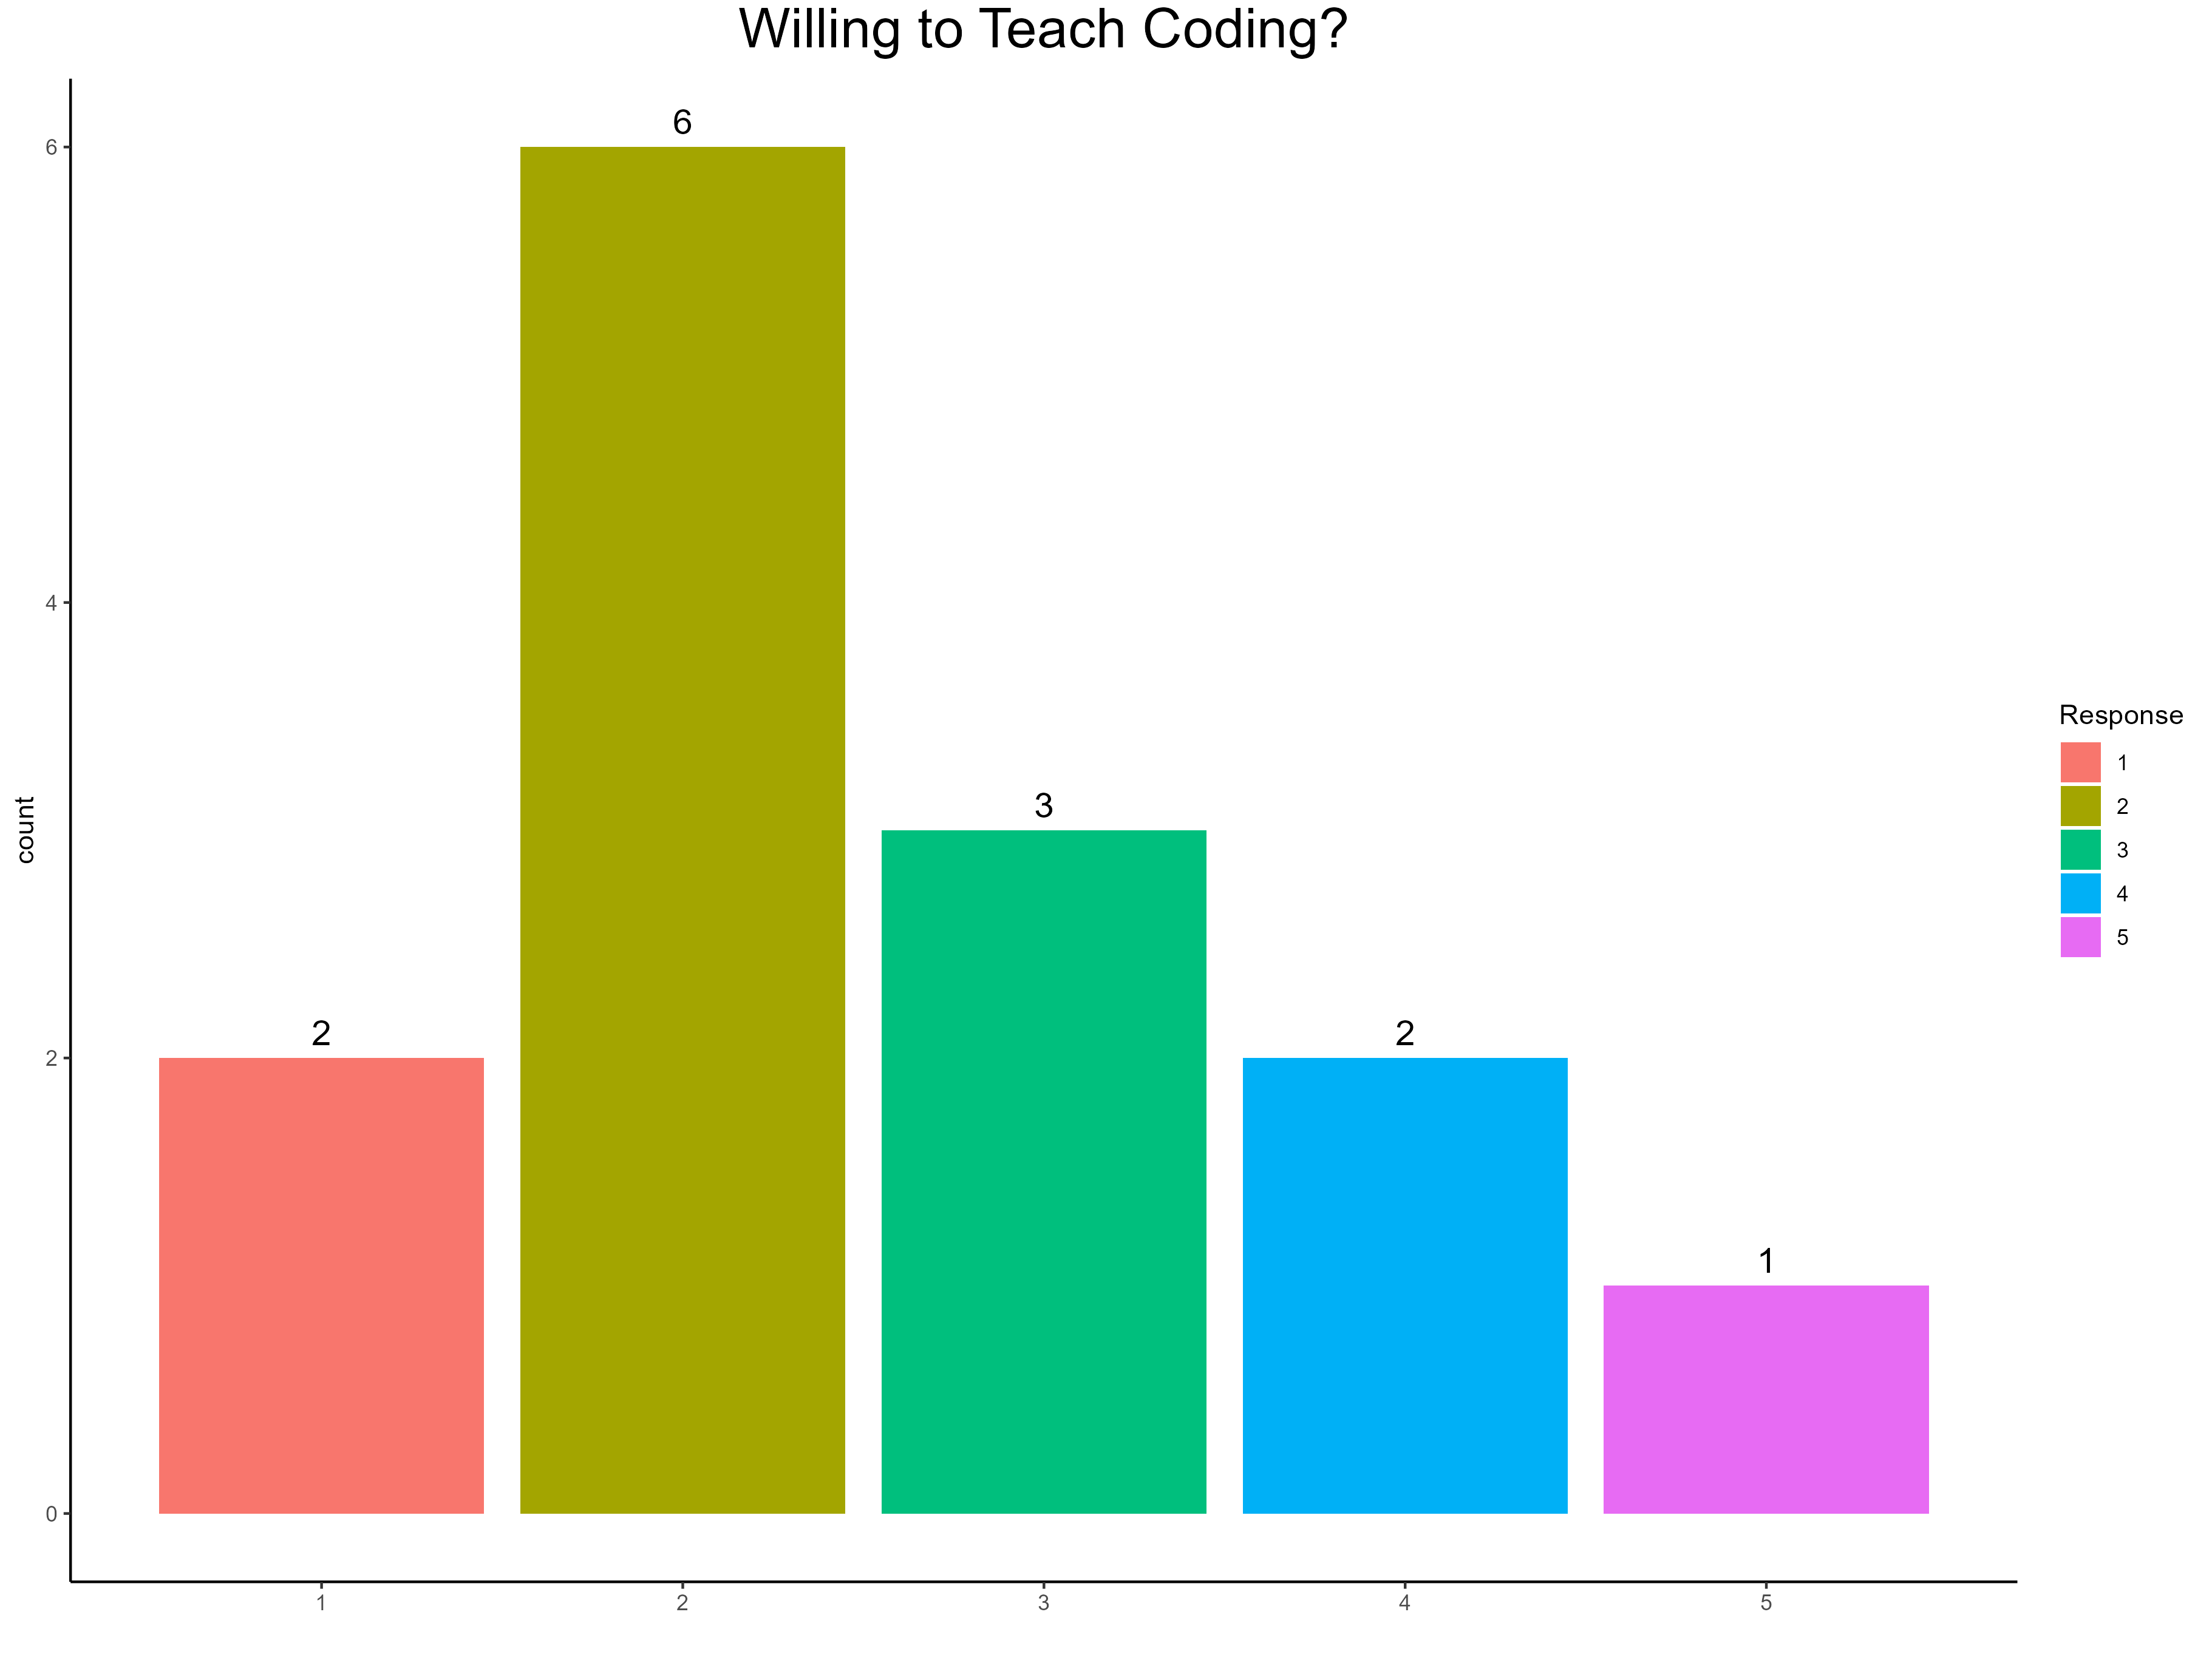
Coding Confidence

Slide 14
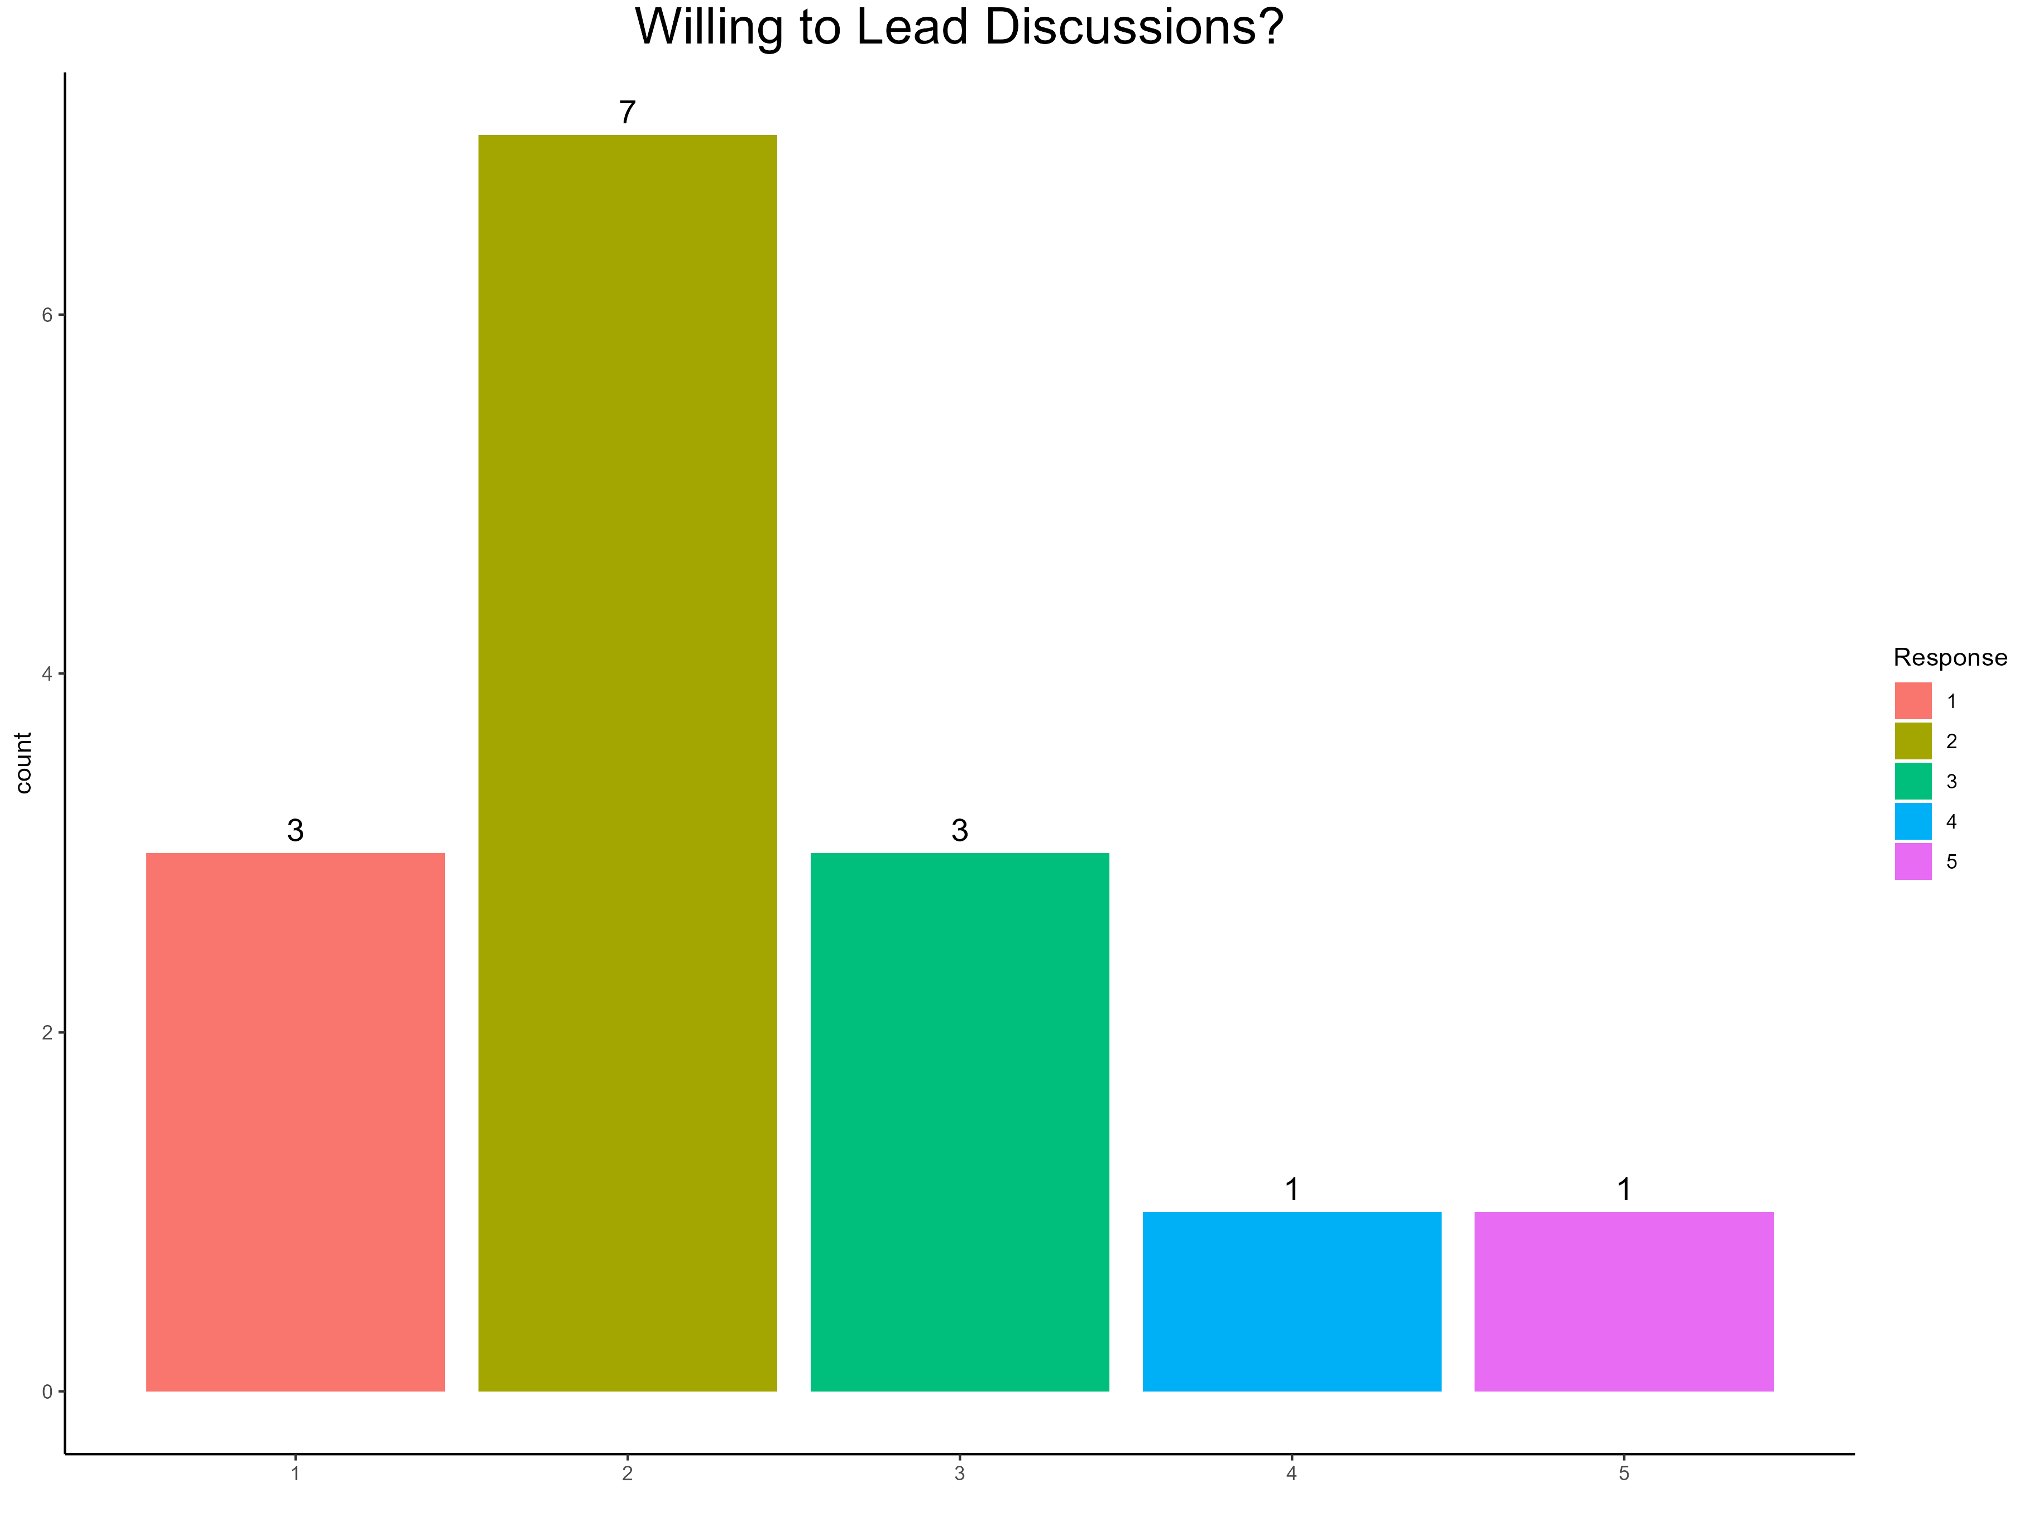

Giving Lectures
Lmk if you change your mind!

Slide 15
Why are you here?
ChatGPT: “Hands-on coding to preprocess, analyze, and interpret neuroimaging data from scratch.”
Notes:
Here’s what we all have in common – now I’d like to know what, in particular, brings each of us here, individually

Slide 16
Introductions (again)
Who are you?
(1) Name, (2) year/school, (3) lab, (4) motivation, (5) fun fact
(1) Craig, (2) 2nd year (GSAS; PhD), (3) Morris/Connelly, (4) practice coding, learn new tools, and develop course material, (5) I’ve performed at Carnegie Hall
Notes:
Here’s what we all have in common – now I’d like to know what, in particular, brings each of us here, individually

Slide 17
Agenda
Summer schedule
Projects
GitHub repository
Anaconda
Viewing MR images with Nibabel
Hacking time: python review / coding practice
Notes:
I want to talk about the schedule and the content we plan to cover
I want to discuss the prospect of projects – see who has a project, who needs one, who is amenable to group projects

Slide 18
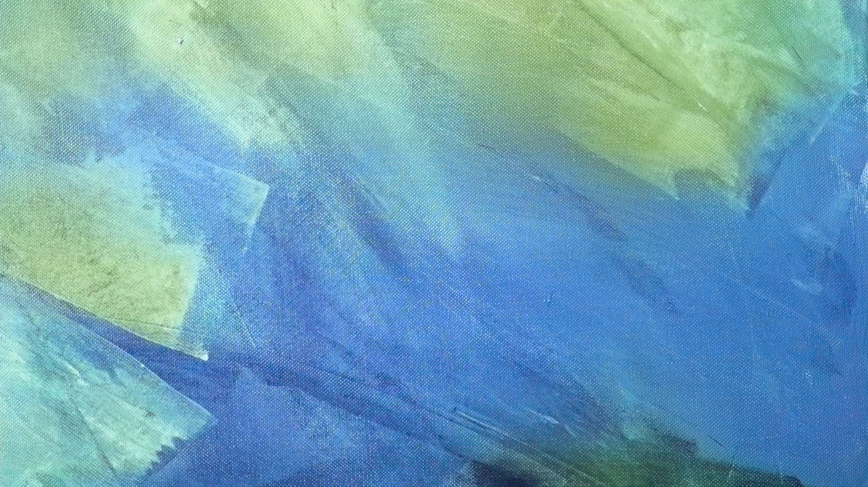
Schedule
30 May
Intro & setup
6 June
MR fundamentals
13 June
Data Org. / BIDS
20 June
Preprocessing / Containers
27 June
Running fMRIPrep
7 Apr.
Holiday
Notes:
How do we feel about this?
Pacing depends on group progress, so our schedule will always be tentative
Current focus on MRI: I can teach MRI, but I’m fuzzy on EEG/fNIRS…

Slide 19

Projects
Who plans to attend “hacking” hours?
Who has/needs a project?
Brainstorming!
Notes:
Teams?
I can come up with activities for the group to kick off each hacking session – e.g., explore the nibabel documentation
- Set up a simple analysis pipeline for your lab
- MR meta-analysis w/ GingerALE
- QC visualizations in Python
- Create a website/Wiki for yourself
- Generate stimuli in PsychoPy

Slide 20

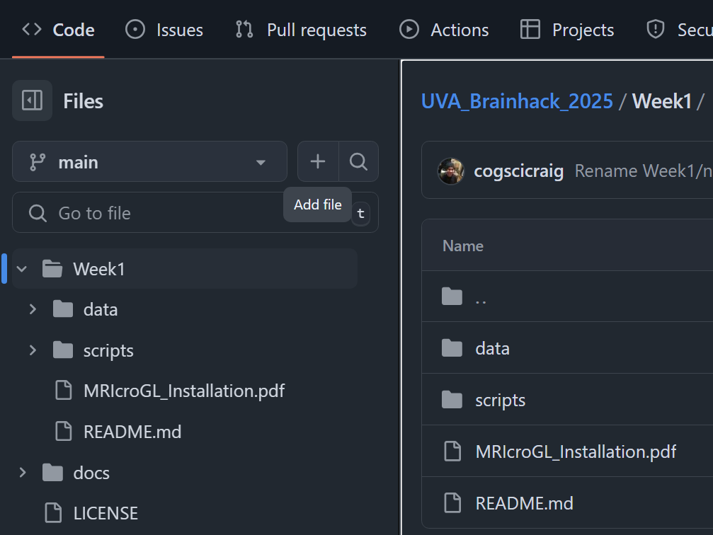
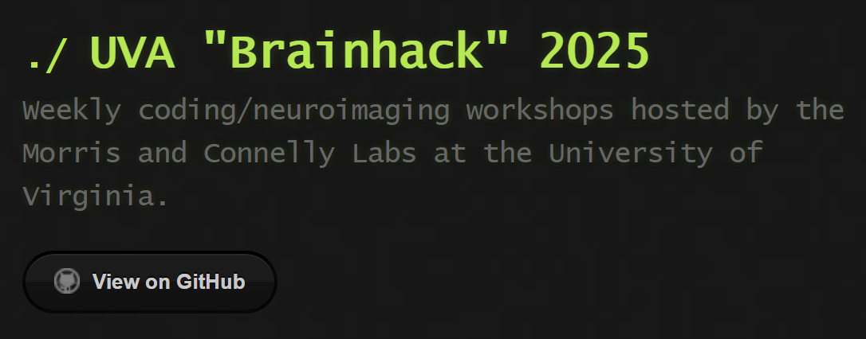
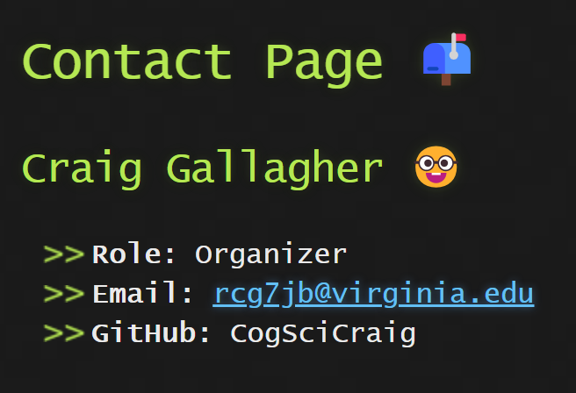
GitHub
Repository: https://github.com/cogscicraig/UVA_Brainhack_2025
Contains slides and scripts
Website: https://cogscicraig.github.io/UVA_Brainhack_2025
Contains links to schedule and contact info
Let me know if you plan to work in teams!
GitHub is great for collaborating on projects

Slide 21
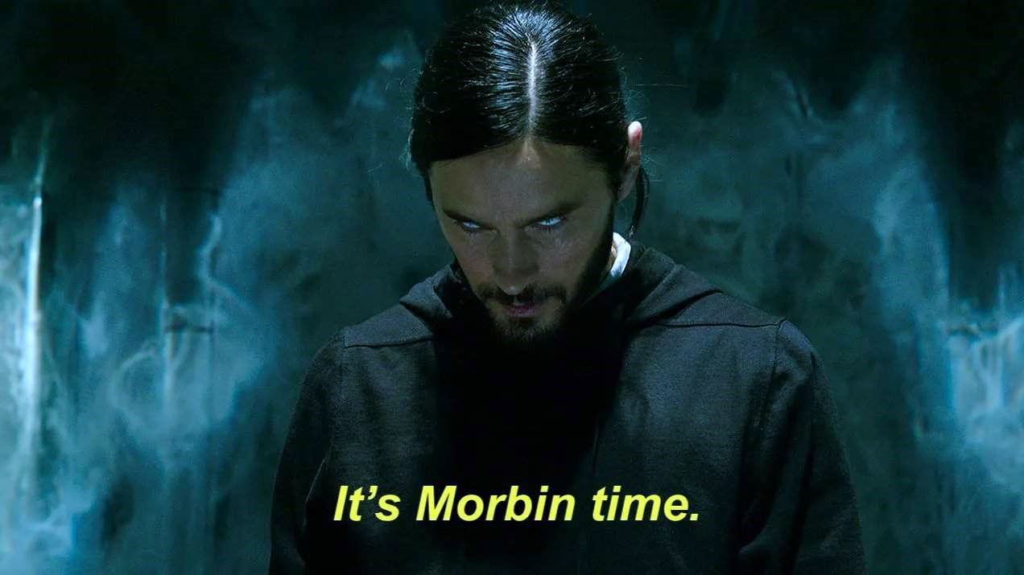
Coding

Slide 22

Anaconda
Install: https://www.anaconda.com/download
Verify installation
>> conda --version
Set up a new conda environment
>> conda create -n brainhack2025 python=3.11 -y
>> conda activate brainhack2025
>> python -V ← should return 3.11
>> conda install –c conda-forge nibabel matplotlib numpy -y
Notes:
If you already have anaconda installed, run:
>> conda update conda
>> conda update --all
What is Anaconda?
Anaconda is a distribution of Python / R that’s geared toward data science and scientific computing
Comes with a full Cpython build, conda (a package and environment manager), ~250 curated packages, and a GUI launcher (Anaconda Navigator)
Conda-forge is a build se3

Slide 23
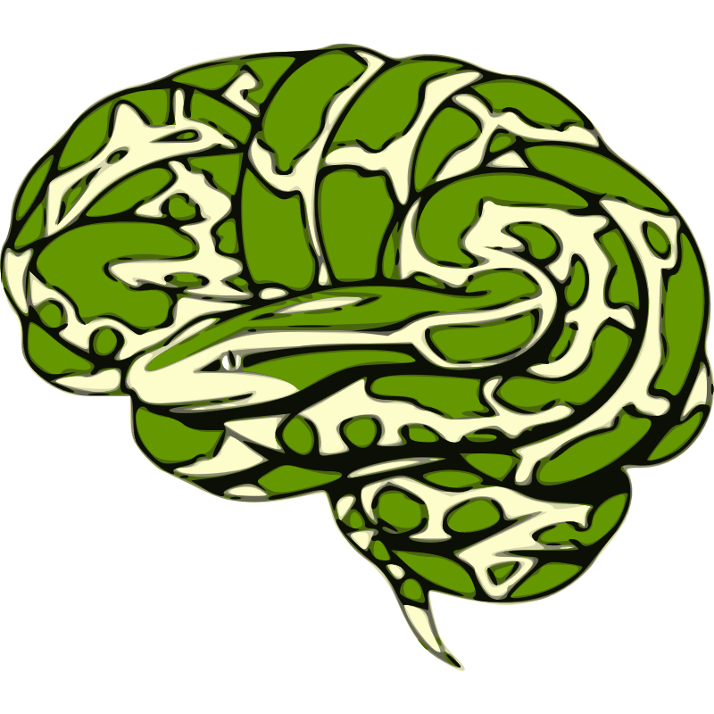
Viewing MR images with Nibabel
Let’s code!
Create a new folder for Brainhack Week1
>> mkdir -p ~/Desktop/Brainhack/Week1
>> cd ~/Desktop/Brainhack/Week1
Open a new interactive python editor
>> jupyter notebook
Follow along ☺
Notes:
On Windows – try Powershell. If only have cmd:
>> md ~/Desktop/Brainhack/Week1
When finished, don’t forget to run:
>> conda deactivate

Slide 24
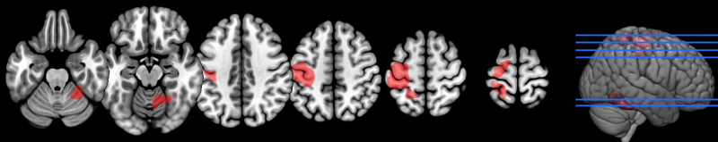
MRIcroGL
Install instructions: https://github.com/cogscicraig/UVA_Brainhack_2025/blob/main/Week1/MRIcroGL_Installation.pdf
Main page: https://www.nitrc.org/plugins/mwiki/index.php/mricrogl:MainPage

Slide 25

Bonus Activities!
Intro to shell scripting (Unix)
https://andysbrainbook.readthedocs.io/en/latest/unix/Unix_Intro.html
Intro to Python
https://lukas-snoek.com/introPy/solutions/week_1/0_introduction.html
Explore the nibabel documentation
https://nipy.org/nibabel/gettingstarted.html
Notes:
Install Cygwin on Windows to follow Unix tutorial

